Slide 1
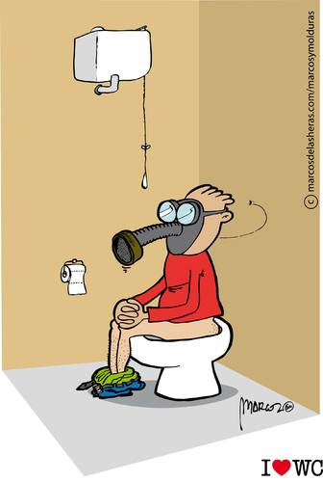
The Behaviour of Gases
Chapter 11

Slide 2
Kinetic Molecular Theory of Gases
This theory describes what we refer to as an “ideal gas”.
The volume of an individual gas molecule is negligible compared to the volume of the container holding the gas. Thus the molecules are very far apart and gases are considered compressible.
There are neither attractive nor repulsive forces between gas molecules.
Gas molecules have high translational energy.
Collisions of gas molecules are completely elastic, thus when gas molecules collide there is no loss in kinetic energy.
The average kinetic energy of gas molecules is directly proportional to temperature as well as mass and inversely proportional to pressure.

Slide 3
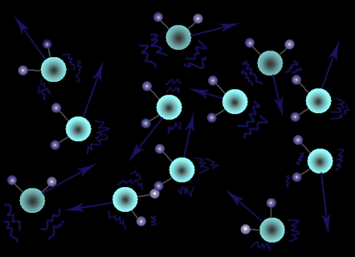
States of Matter and the KMT
Types of Motion:
Translational Motion – the independent motion of particles from one point in space to another
Rotational Motion – the motion of particles around other particles
Vibrational Motion – the back and forth motion of particles that are fixed in position

Slide 4
States of Matter and the KMT
Comparing Solids, Liquids & Gases:
SOLIDS | LIQUIDS | GASES
Incompressible (definite volume) | Incompressible (definite volume) | Compressible (indefinite volume)
Crystal lattice (fixed structure) | Indefinite shape | Indefinite shape
Cannot flow | Flows (According to gravity) | Flows (In all directions)
Vibrational Motion | Vibrational Motion Rotational Motion | Vibrational Motion Rotational Motion Translational Motion
Very low Degree of Disorder | Medium Degree of Disorder | Very High Degree of Disorder
Strongest attractive forces between particles | Strong attractive forces between particles | Weakest attractive forces between particles

Slide 5
States of Matter and the KMT
Intermolecular Forces:
Forces between neutral molecules or between molecules & ions
Dipole-dipole Forces – the positive pole of one polar molecule is attracted to the negative pole of another polar molecule.
Weak Dispersion Forces – a temporary force of attraction between non-polar molecules
Temperature: the average kinetic energy of the particles in a substance
Kinetic energy: the energy of motion

Slide 6
HOMEWORK
Read text p.416-423
-make notes by following questions on gas handout package
(Kinetic Molecular Theory = KMT)
-Text Questions p.423 #1-8

Slide 7
GAS LAWS

Slide 8
Introduction to Gas Laws
The gas laws look at four factors:
Volume (L)
Volume of a container
Temperature (K)
Measure of kinetic energy
Pressure (kPa)
P = F/A (N/m²)
Mass (g)
The Law of Proportionality
If a α b we will introduce a constant “k”
Then a = kb

Slide 9
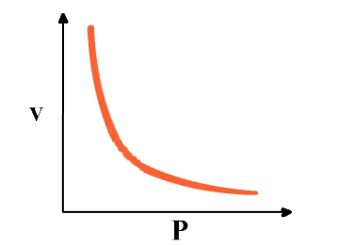
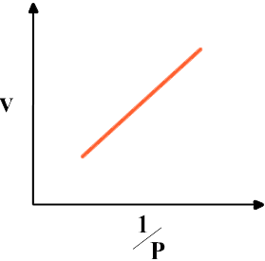


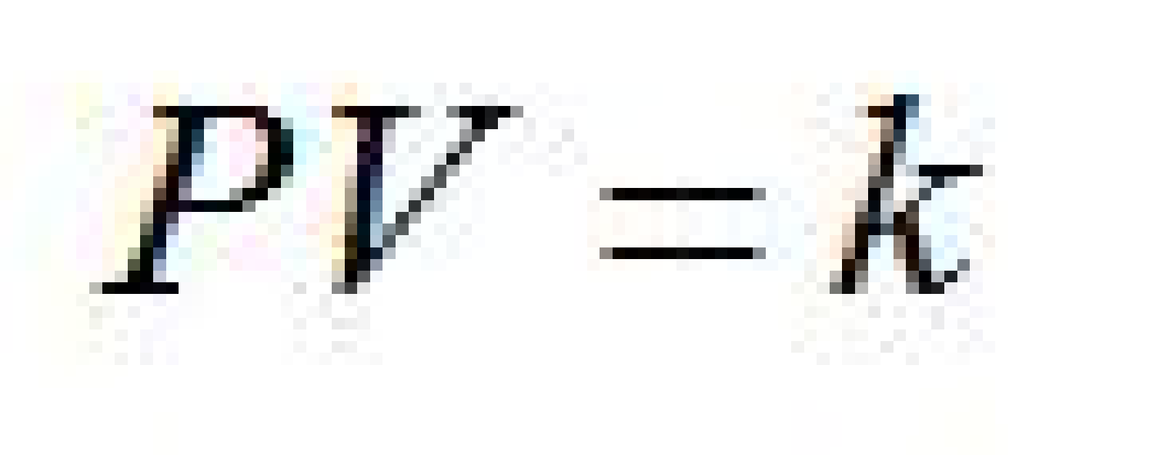

Boyle’s Law
The volume of a fixed mass of gas varies inversely with the applied pressure when the temperature is kept constant.
Thus
We can rearrange this formula to yield
Since k is a constant, it is true for a gas at any pressure!
Thus for case 1 (initial conditions) and case 2 (final conditions)

Slide 10
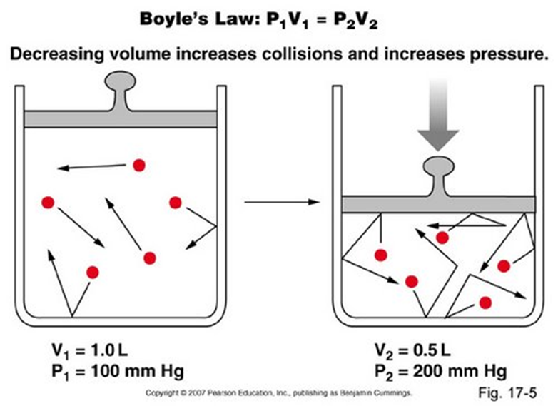
Boyle’s Law

Slide 11
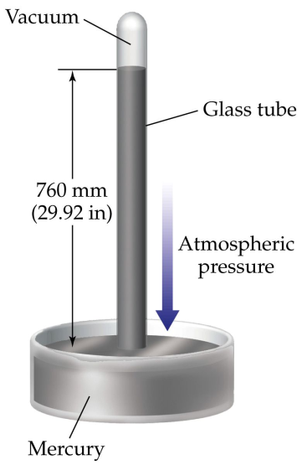
Boyle’s Law
The Units!
Volume must be measured in litres (L) or cubic centimetres (cm³) and pressure usually in kilopascals (kPa), but other units are accepted.
Standard atmospheric pressure at 0°C
is 101.3 kPa
Numerous units may be used for pressure
atm atmospheres
mm Hg millimeters of mercury
torr torr
psi pounds per square inch
101.3 kPa = 1 atm = 760 mm Hg
= 760 torr = 14.7 psi

Slide 12
Boyle’s Law
Sample Problem:
A 4.50 L balloon filled with helium is collected at room temperature and standard atmospheric pressure. The balloon is then submerged in a tub of water, also at room temperature such that the external pressure is increased to 110.2 kPa.
What is the final volume of the balloon?
Practice Problems: p.434 #1-4
p.435 #1-6

Slide 13
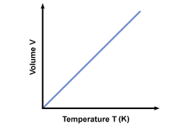
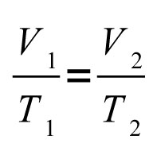
Charles’ Law
The volume of a fixed mass of gas is proportional to its temperature when the pressure is kept constant.
V α T
Thus V = kT
We can rearrange this formula to yield k = V/T
Since k is a constant it is true for a gas at any temperature!
Thus for case 1 (initial conditions) and case 2 (final conditions)

Slide 14
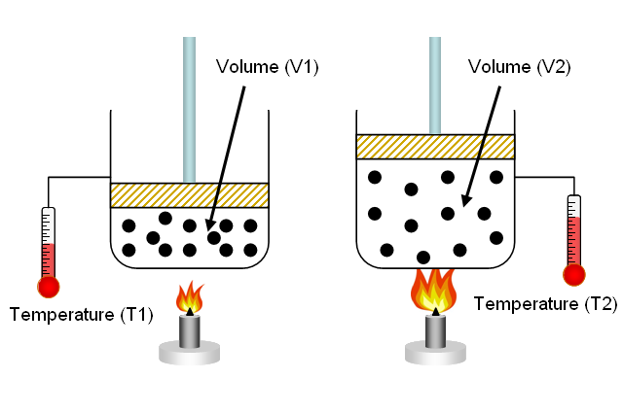
Charles’ Law

Slide 15
Charles’ Law
There is a catch!
Temperature must be measured in Kelvin and volume in litres
The Kelvin scale is similar to the Celsius scale (in graduations)
To determine the Kelvin temperature just add 273.15 to the Celsius scale (we will use 273)
T_{K} = T_{°C} + 273
Unlike other temperature scales K has no ° symbol.
B.P. of water 100°C 373 K
Body Temp. 37°C 310 K
F.P. of water 0°C 273 K
Absolute Zero -273°C 0 K
Present and Previous Names for these scales:
Celsius ⭢ Centigrade
Kelvin ⭢ Absolute

Slide 16
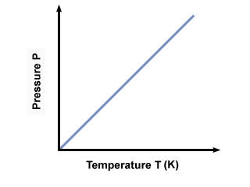
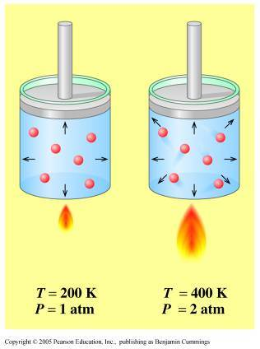
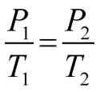

Gay-Lussac’s Law
The pressure of a fixed mass of gas varies directly with the temperature when the volume is kept constant.
Thus P = kT
We can rearrange this formula to yield k = P/T
Since k is a constant it is true for a gas at any temperature!
Thus for case 1 (initial conditions) and case 2 (final conditions):

Slide 17
Gay-Lussac’s Law
There is a catch!
Temperature must be measured in Kelvin (K) and pressure usually in kilopascals (kPa), but other units are accepted.
Recall:
101.3 kPa = 1 atm = 760 mmHg = 760 torr = 14.7 psi
STP 101.3 kPa & 0º C & 273 K

Slide 18
Sample Problems:
A balloon is filled with helium at standard atmospheric pressure and 22.5ºC. When I took the balloon outside, the pressure was 90.1 kPa. What was the outside temperature in ºC?
The pressure gauge reading on a cylinder of oxygen gas is 8.5 x 10³ kPa, at 22ºC. What will be the pressure if the cylinder is placed in boiling water?
Practice problems: p.446 #5,6,8-12
p.449 #13 – 16
p.451 #1-5

Slide 19

Combining The Gas Laws…
Look at all the gas laws we have considered…
Can you create a relationship that accounts for all of them in one formula?
Work with a partner and try to figure it out…
2 new “standard conditions”
STP – 0ºC and 101.3 kPa (at sea level)
SATP – standard ambient temperature & pressure 25ºC and 100 kPa (room conditions)

Slide 20
Sample problems…
For my son’s birthday, a party store filled a 745 mL balloon with helium at SATP. When I took the balloon outside, the temperature was -9.4 ºC and the atmospheric pressure was 99.7 kPa. What was the volume of the helium outside?
To what temperature (in ºC) must 25.0 mL of argon gas at STP be heated such that the new volume is 30.0 mL and the pressure is 110 kPa?
HW:
p.457 #17-21

Slide 21
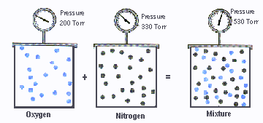
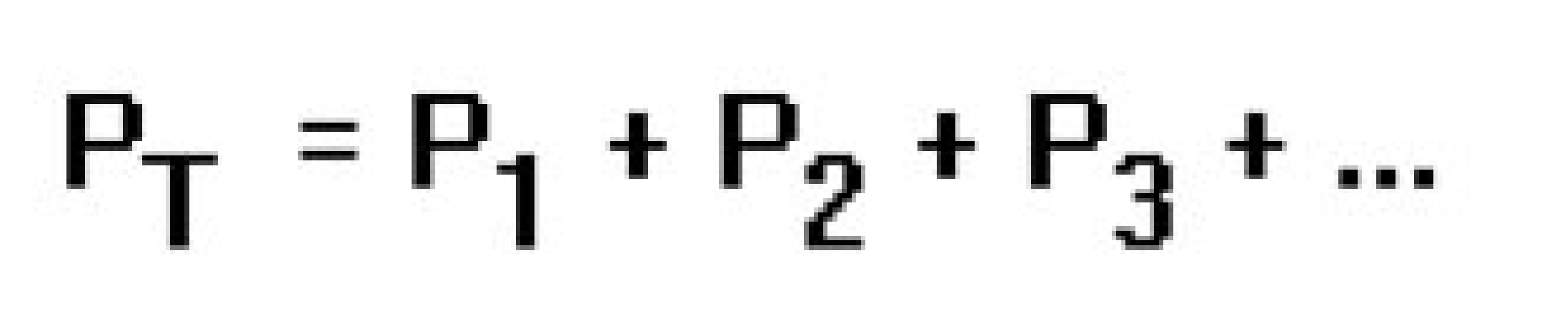
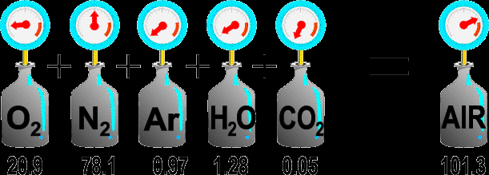
Dalton’s Law of Partial Pressures
The total pressure of a mixture of gases is the sum of the pressures of each of the individual gases
Sample Problem:
What is the pressure contribution of CO₂ to the atmospheric pressure on a very dry day when the barometer reads 0.98 atm?
use table 11.2 p.459

Slide 22

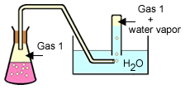
Dalton’s Law of Partial Pressures
DEMO…
When gas is collected over water, , molecules of water vapour mix with the gas sample.
We must subtract the pressure that the water vapour contributes from the total pressure in order to determine the pressure of the gas collected.

Slide 23
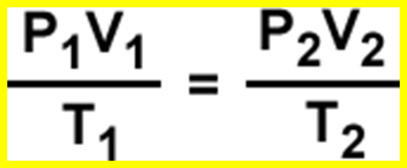
Dalton’s Law of Partial Pressures
Sample problem:
A volume of 110 mL of H₂ _{(g)} is collected over water at a temperature of 17ºC and an atmospheric pressure of 95.0 kPa. What is the volume of dry hydrogen at STP?
See table 12.3 p.507 pressure of water vapour
P_{T} = PH₂ + PH₂O
P₁H₂ = P_{T} – PH₂O
= 95.0 kPa – 1.94 kPa
= 93.1 kPa
V₁ = 110 mL
T₁ = 17 _{o}C = 290 K
P₂ = 101.3 kPa
T₂ = 273K
V₂ = ?
HW: complete Q#1-4 on handout

Slide 24
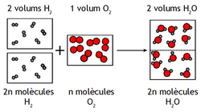
Our friend Gay-Lussac was confused!
When he combined 2 volumes of hydrogen and 1 volume of oxygen, he got only two volumes of water vapour. What was going on? (see p.472 – 474)
Gay-Lussac did not know that gas molecules could contain more than one atom!
He consulted with Dalton (law of multiple proportions) and they published their results.
Avogadro figured it out!

Slide 25
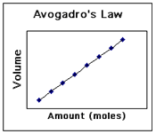


Avogadro’s Hypothesis
Equal volumes of gases at the same temperature and pressure contain the same number of molecules.
Thus V = kn
We can rearrange this formula to yield k = V/n
Since k is constant it is true for a gas at any pressure!
Thus for case 1 (initial conditions) and case 2 (final conditions)
The Units!
Volume must be measured in litres (L) or cubic centimetres (cm³)

Slide 26
Avogadro’s Hypothesis
Sample Problem:
For my son’s birthday, a party store filled a 745 mL birthday balloon with 3.2 g helium @ SATP. When I took the balloon home it had a slow leak and lost 0.5 g helium, the temperature was 25 ºC and the atmospheric pressure was 100 kPa. What was the volume of the balloon at home?

Slide 27
Avogadro’s Hypothesis
Sample Problem:
1.30 L of N₂ _{(g)} at 22.0 ºC and 98.0 kPa have a mass of 1.45 g. Use this information to calculate the molar volume of N₂ _{(g)} at STP.
Note: Molar volume is the volume occupied by one mole of a gas.
This is the same for ANY gas at STP 22.4 L
At SATP, the molar volume of any gas is 24.8 L
HW: p.477 #1,3 & 4
p.482 #5,6,6,10

Slide 28
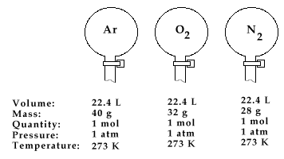

Slide 29
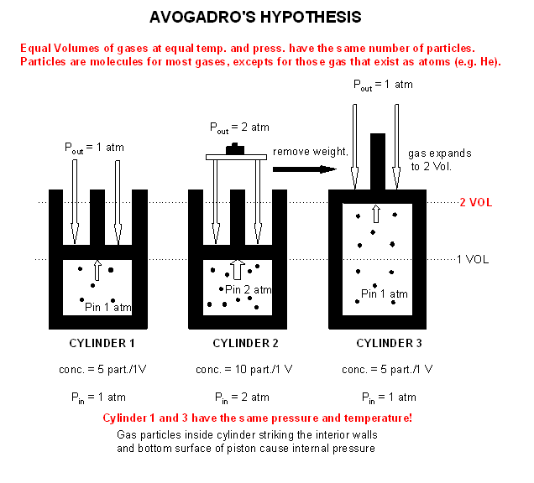
Gay-Lussac’s Law

Slide 30
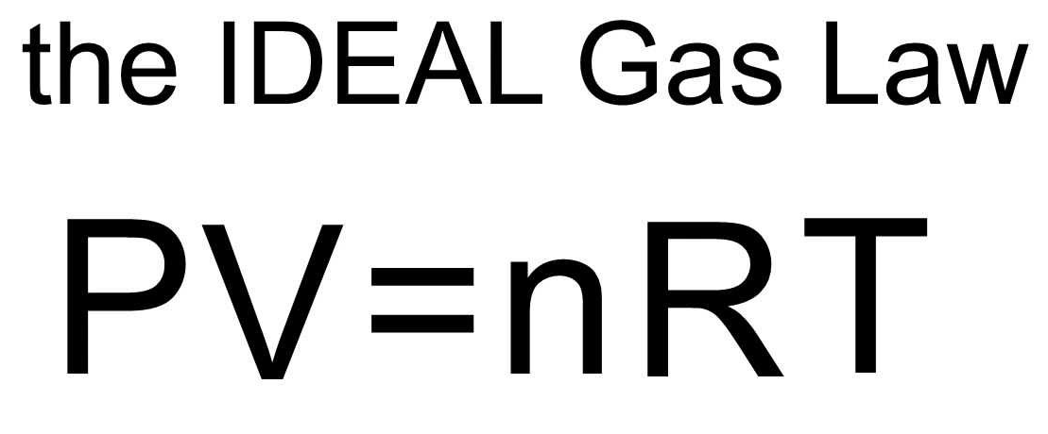
What if we consider Avagadro’s law too…

Slide 31
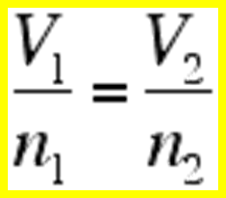
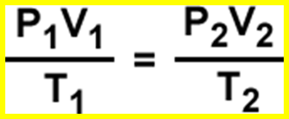
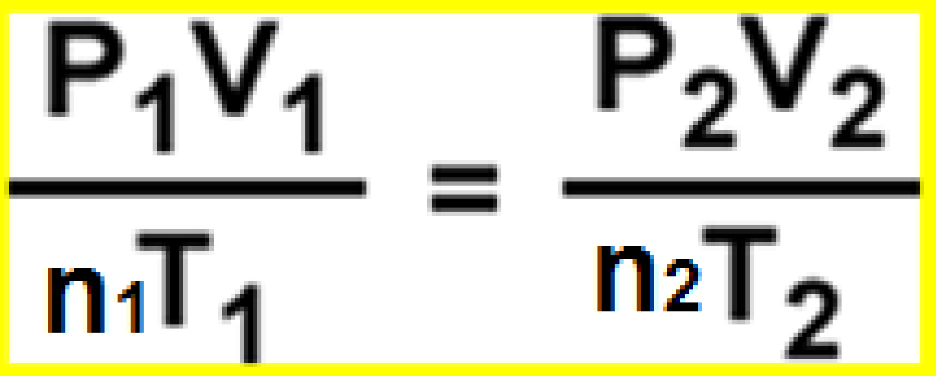
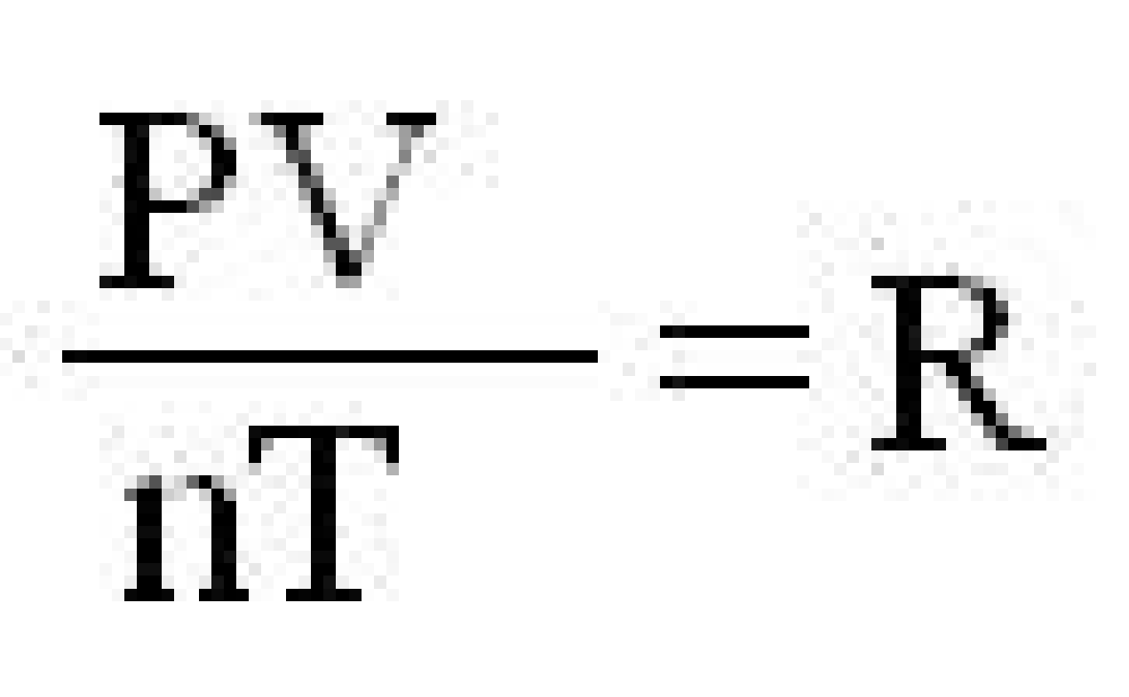
Ideal Gas Law
How did we get there??
Recall: (for constant T & P)
And (for a fixed amount of gas)
Therefore
This means
Where: R = Universal Gas Law Constant

Slide 32
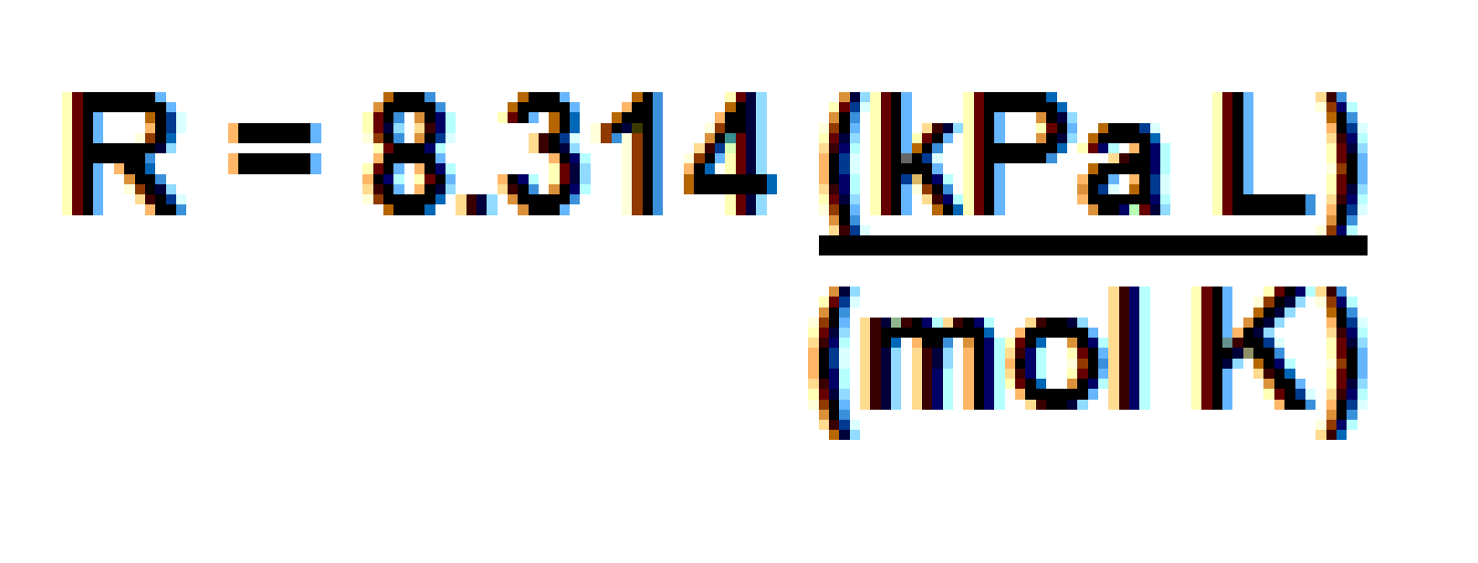
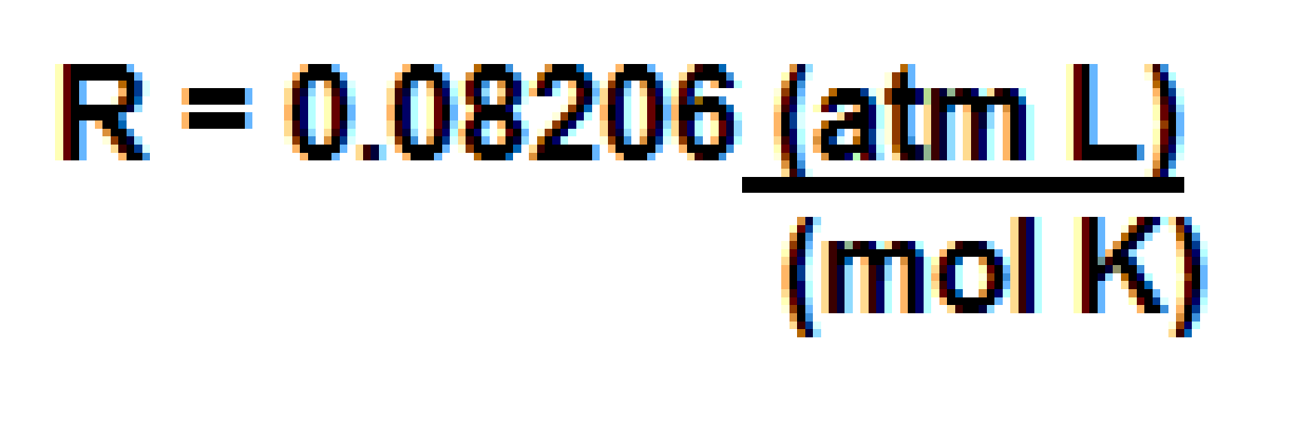
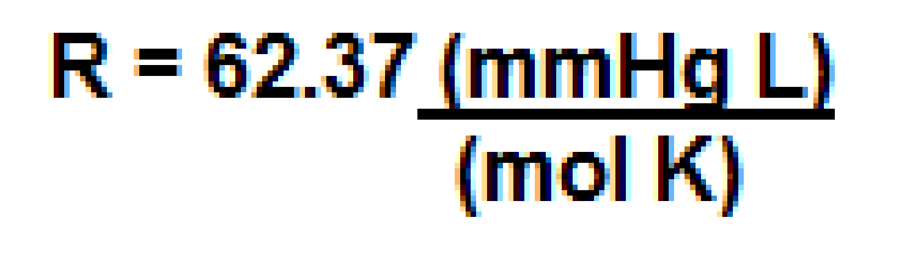

Ideal Gas Law
The value of R can be calculated using one mole of a gas at STP:
P = 101.3 kPa
V = 22.4 L
T = 273 K
n = 1.00 mol
R can also be expressed in other units:
The Ideal Gas Law Equation can be rearranged as:

Slide 33
Ideal Gas Law
Sample Problems:
The pressure gauge on a 15.0 L cylinder of oxygen gas has a reading of 2.70 x 10³ kPa and a temperature of 22.5 ºC. What is the mass of oxygen in the cylinder?
What volume of carbon dioxide did a swimmer breathe out when he exhaled 10.5 g of CO₂ @ SATP into a flask to measure his lung capacity?
HW:
-p.487 # 12-14
-p.488 #1-5

Slide 34
